Slide 1

Virtual Workout Buddy
Deep Learning with Tensorflow Class
4/12/2025

Slide 2
Title Slide
Project Name: Virtual Workout Buddy
Team Members:
Tony Lam
Tong Liu
Ziteng Wang
Van Lam
Tagline: Your AI-powered fitness coach for perfect form!
Logo:

Slide 3
Introduction
Purpose: "Created by fitness enthusiasts and AI experts to help people exercise safely and effectively."
Problem Statement:
Poor workout form → injuries, inefficient results.
Lack of access to personal trainers.
Solution: AI-driven real-time form analysis for everyone.

Slide 4
Mission & Vision
Mission Statement: "Make professional form analysis accessible to everyone, anywhere, anytime."
Core Belief: "Proper form is the foundation of any successful workout routine."
Vision: Democratize fitness coaching with AI.

Slide 5
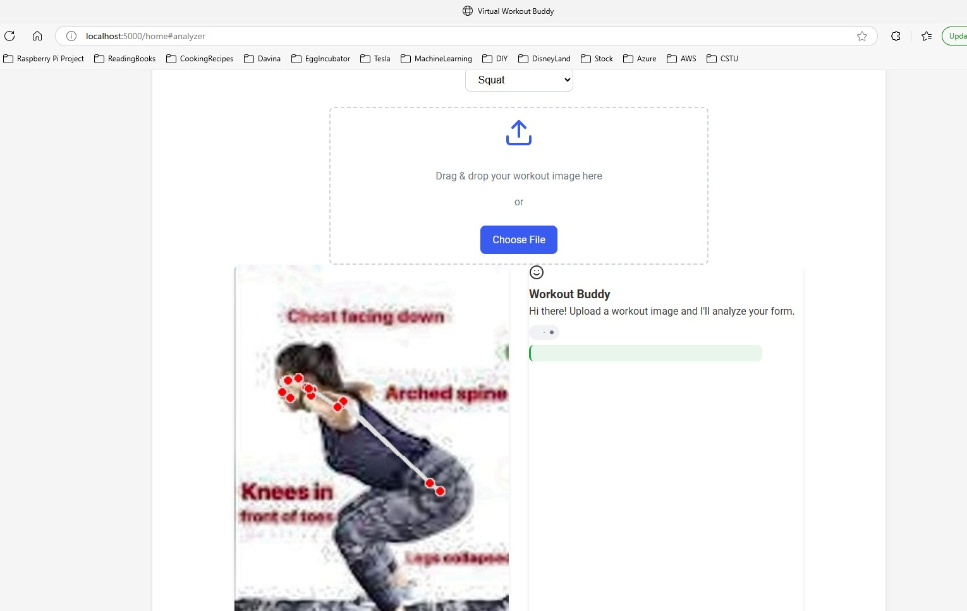
How It Works
Step 1: User uploads workout image/video.
Step 2: AI analyzes posture, joint angles, and movement.
Step 3: Instant feedback with corrections (e.g., "Lower your knees!").

Slide 6
Why Proper Form Matters
Benefits:
� Prevents injuries (e.g., back strain, joint stress).
💪 Maximizes results (targets right muscles).
📈 Long-term progress (builds good habits).

Slide 7
Technology Stack
AI/ML: Pose estimation model (Yolo v11).
Backend: Python, Flask/Django.
Frontend: HTML/CSS/JavaScript.

Slide 8
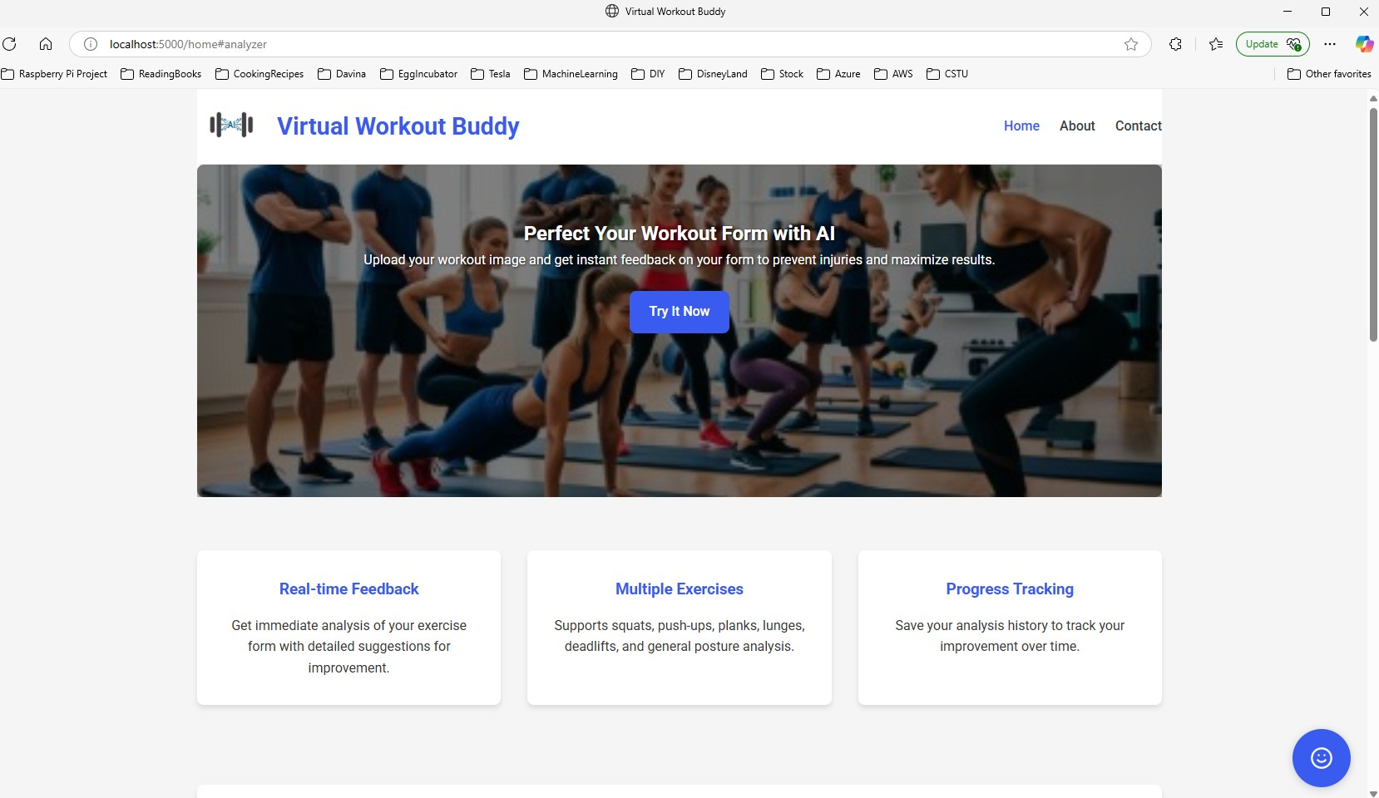
Website
Main page

Slide 9
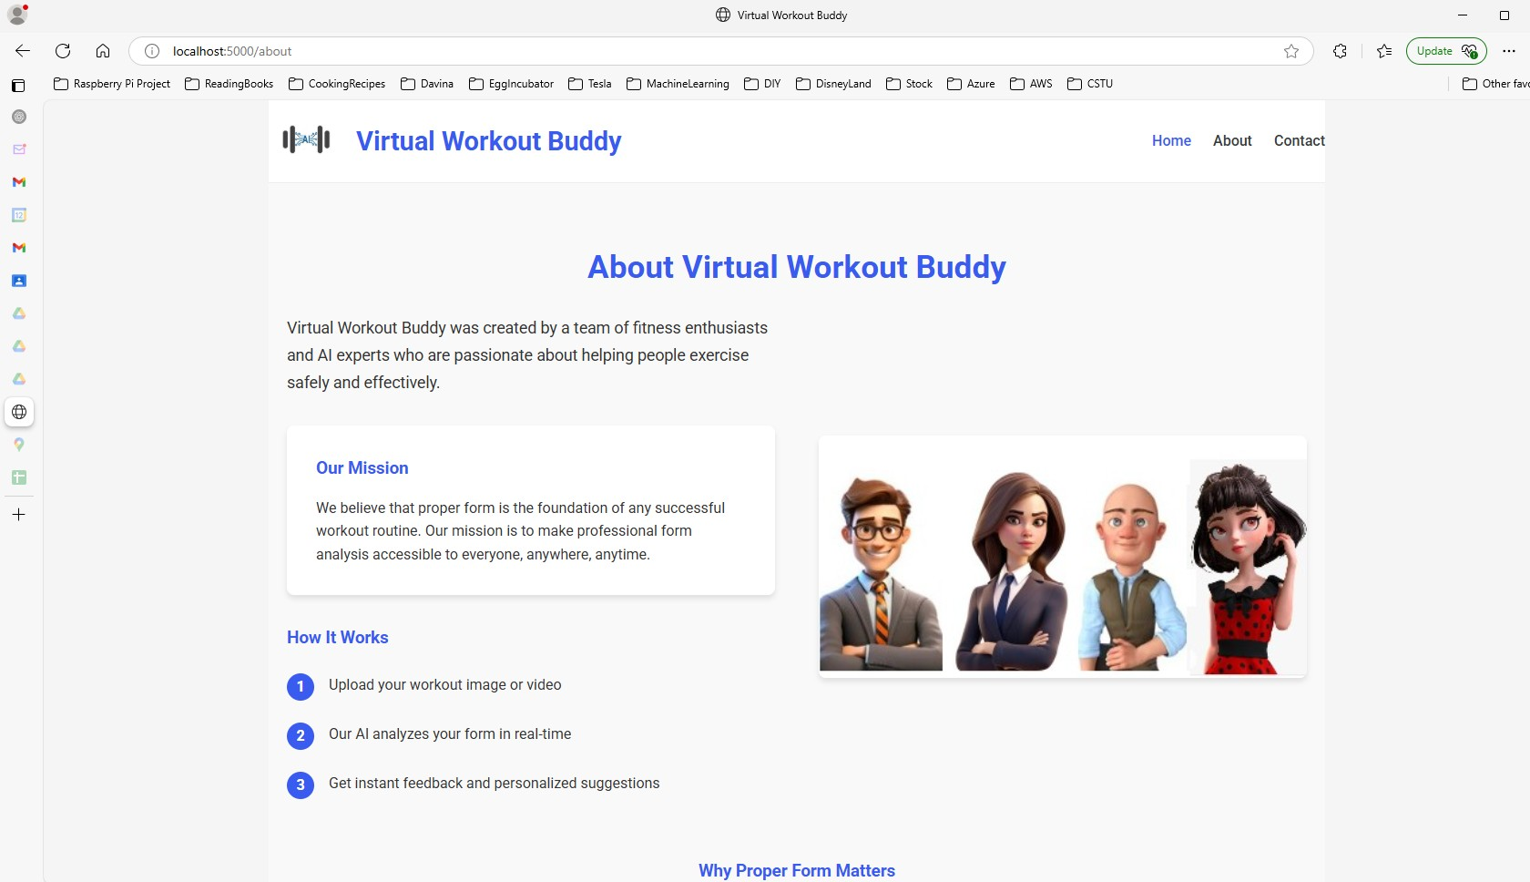
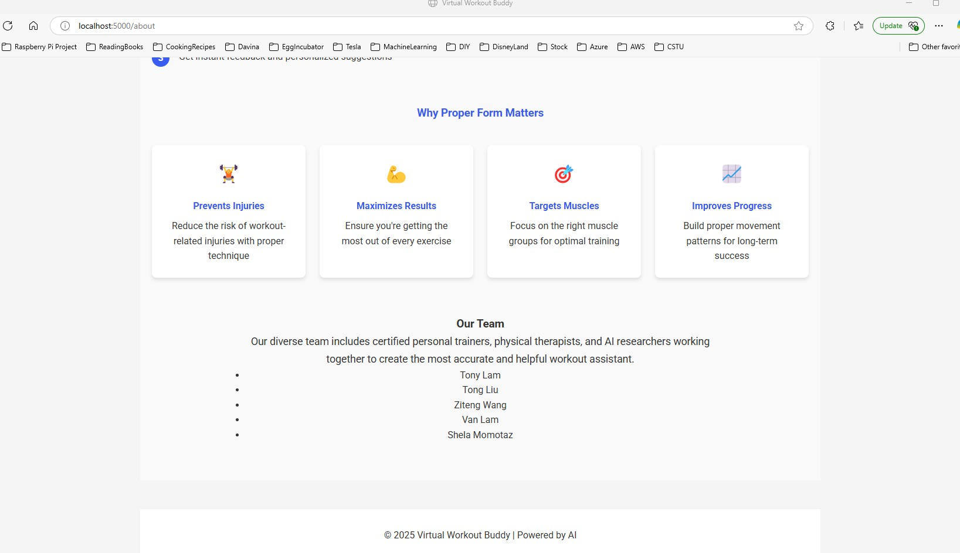
Website (cont.)
About page

Slide 10
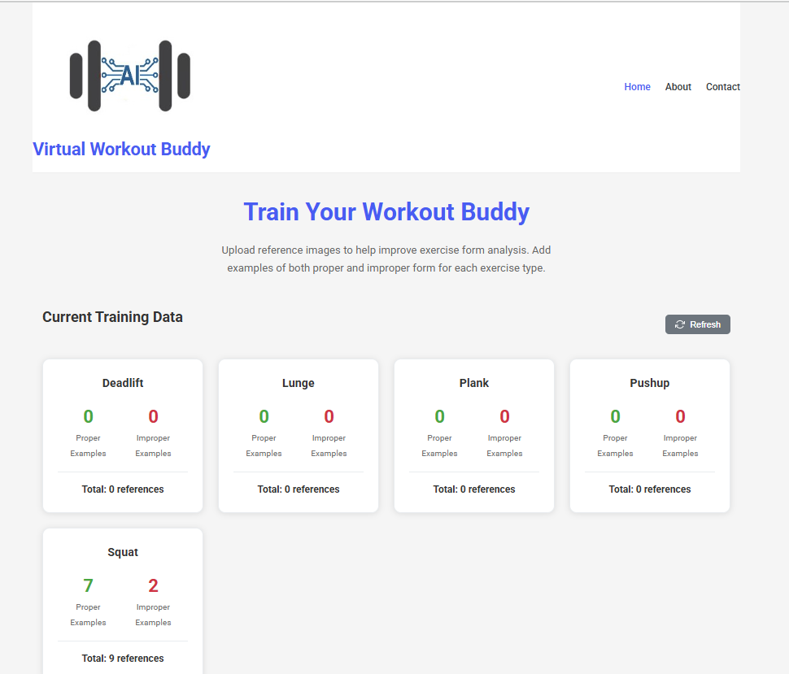
Website Admin
Training LLM Dashboard

Slide 11
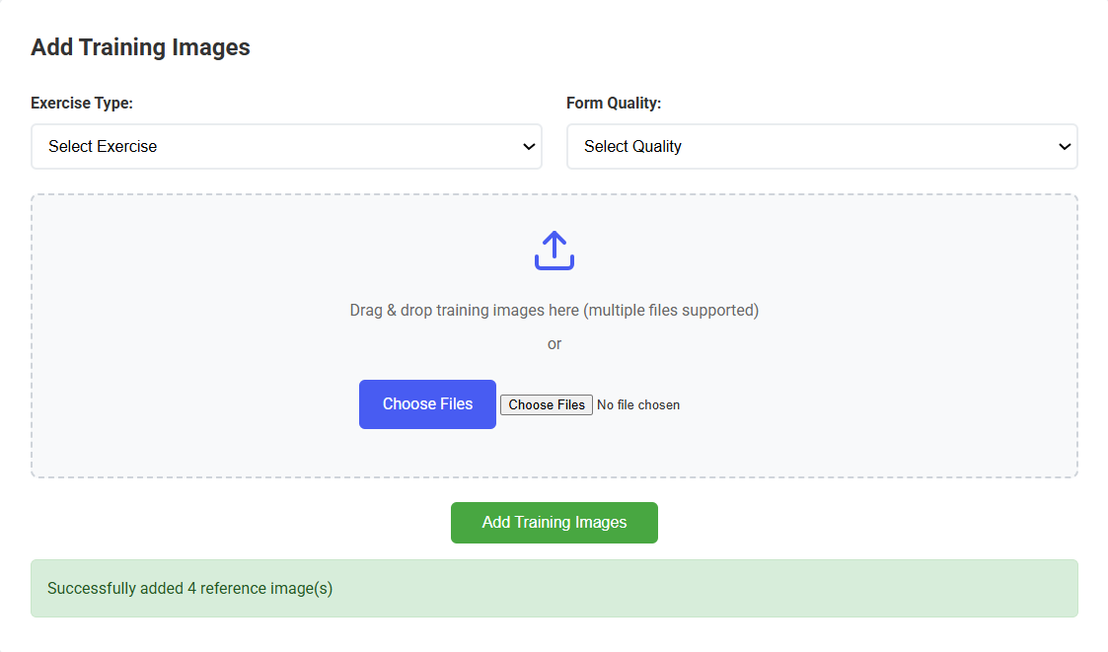
Website Admin
Train LLM with uploads

Slide 12
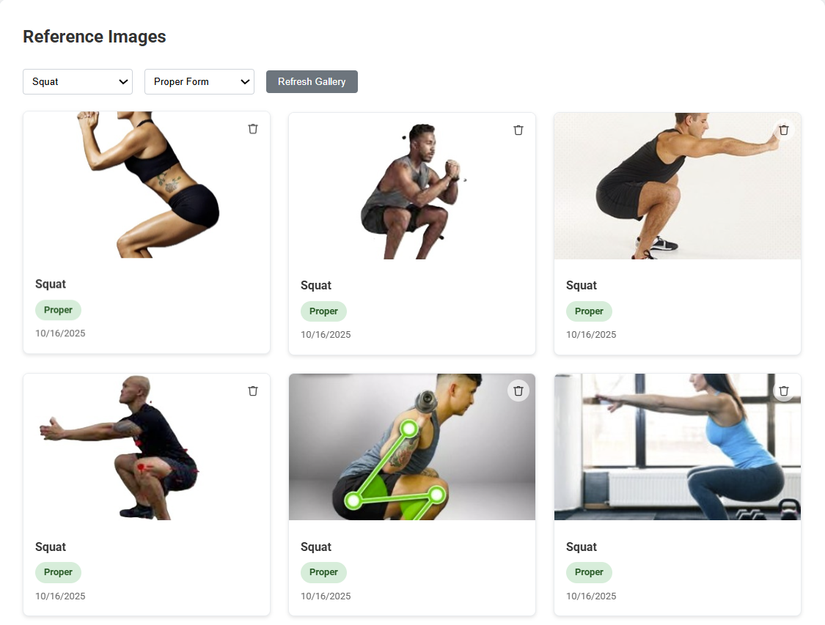
Website Admin (cont.)
Trained LLM
reference images
after upload

Slide 13
Future Roadmap
Plans:
Mobile app development.
Exercise library expansion.
Social features (share progress).

Slide 14
Q&A
"Thank you! Any questions?"

